Slide 1












#MSTechCommunityAPACOnline
Humans of IT
AI for the Music Industry
By Hazel Savage, Musiio CEO and Co-founder

Slide 2


www.musiio.com

Slide 3



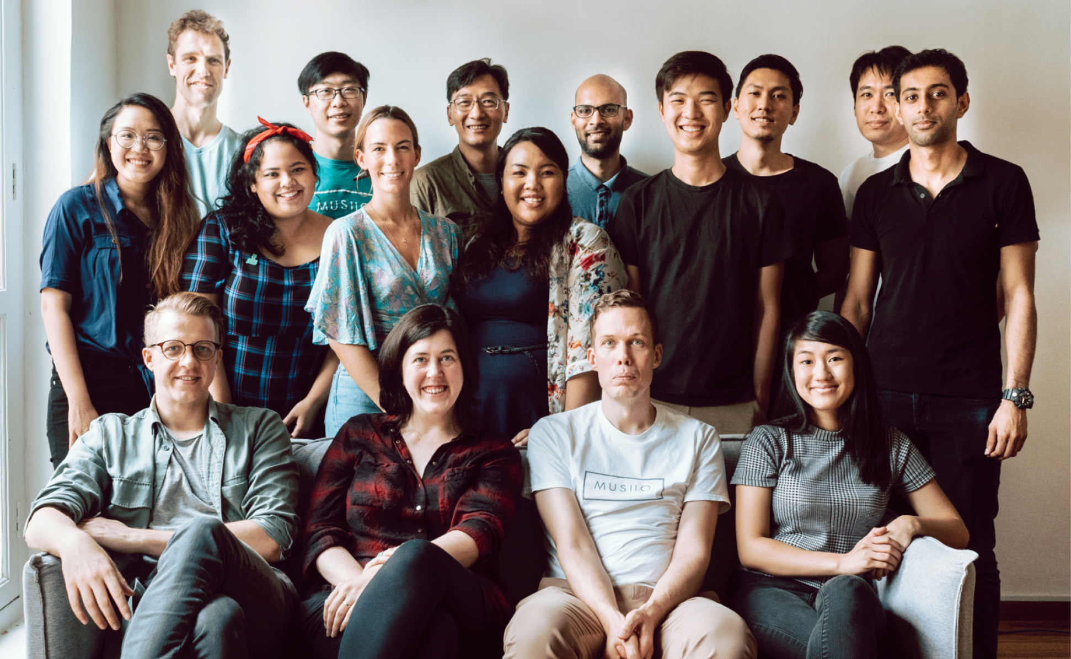






Musiio Team Singapore
Hazel Savage
CEO & Co-Founder
The Team
Aron Pettersson
CTO & Co-Founder

Slide 4
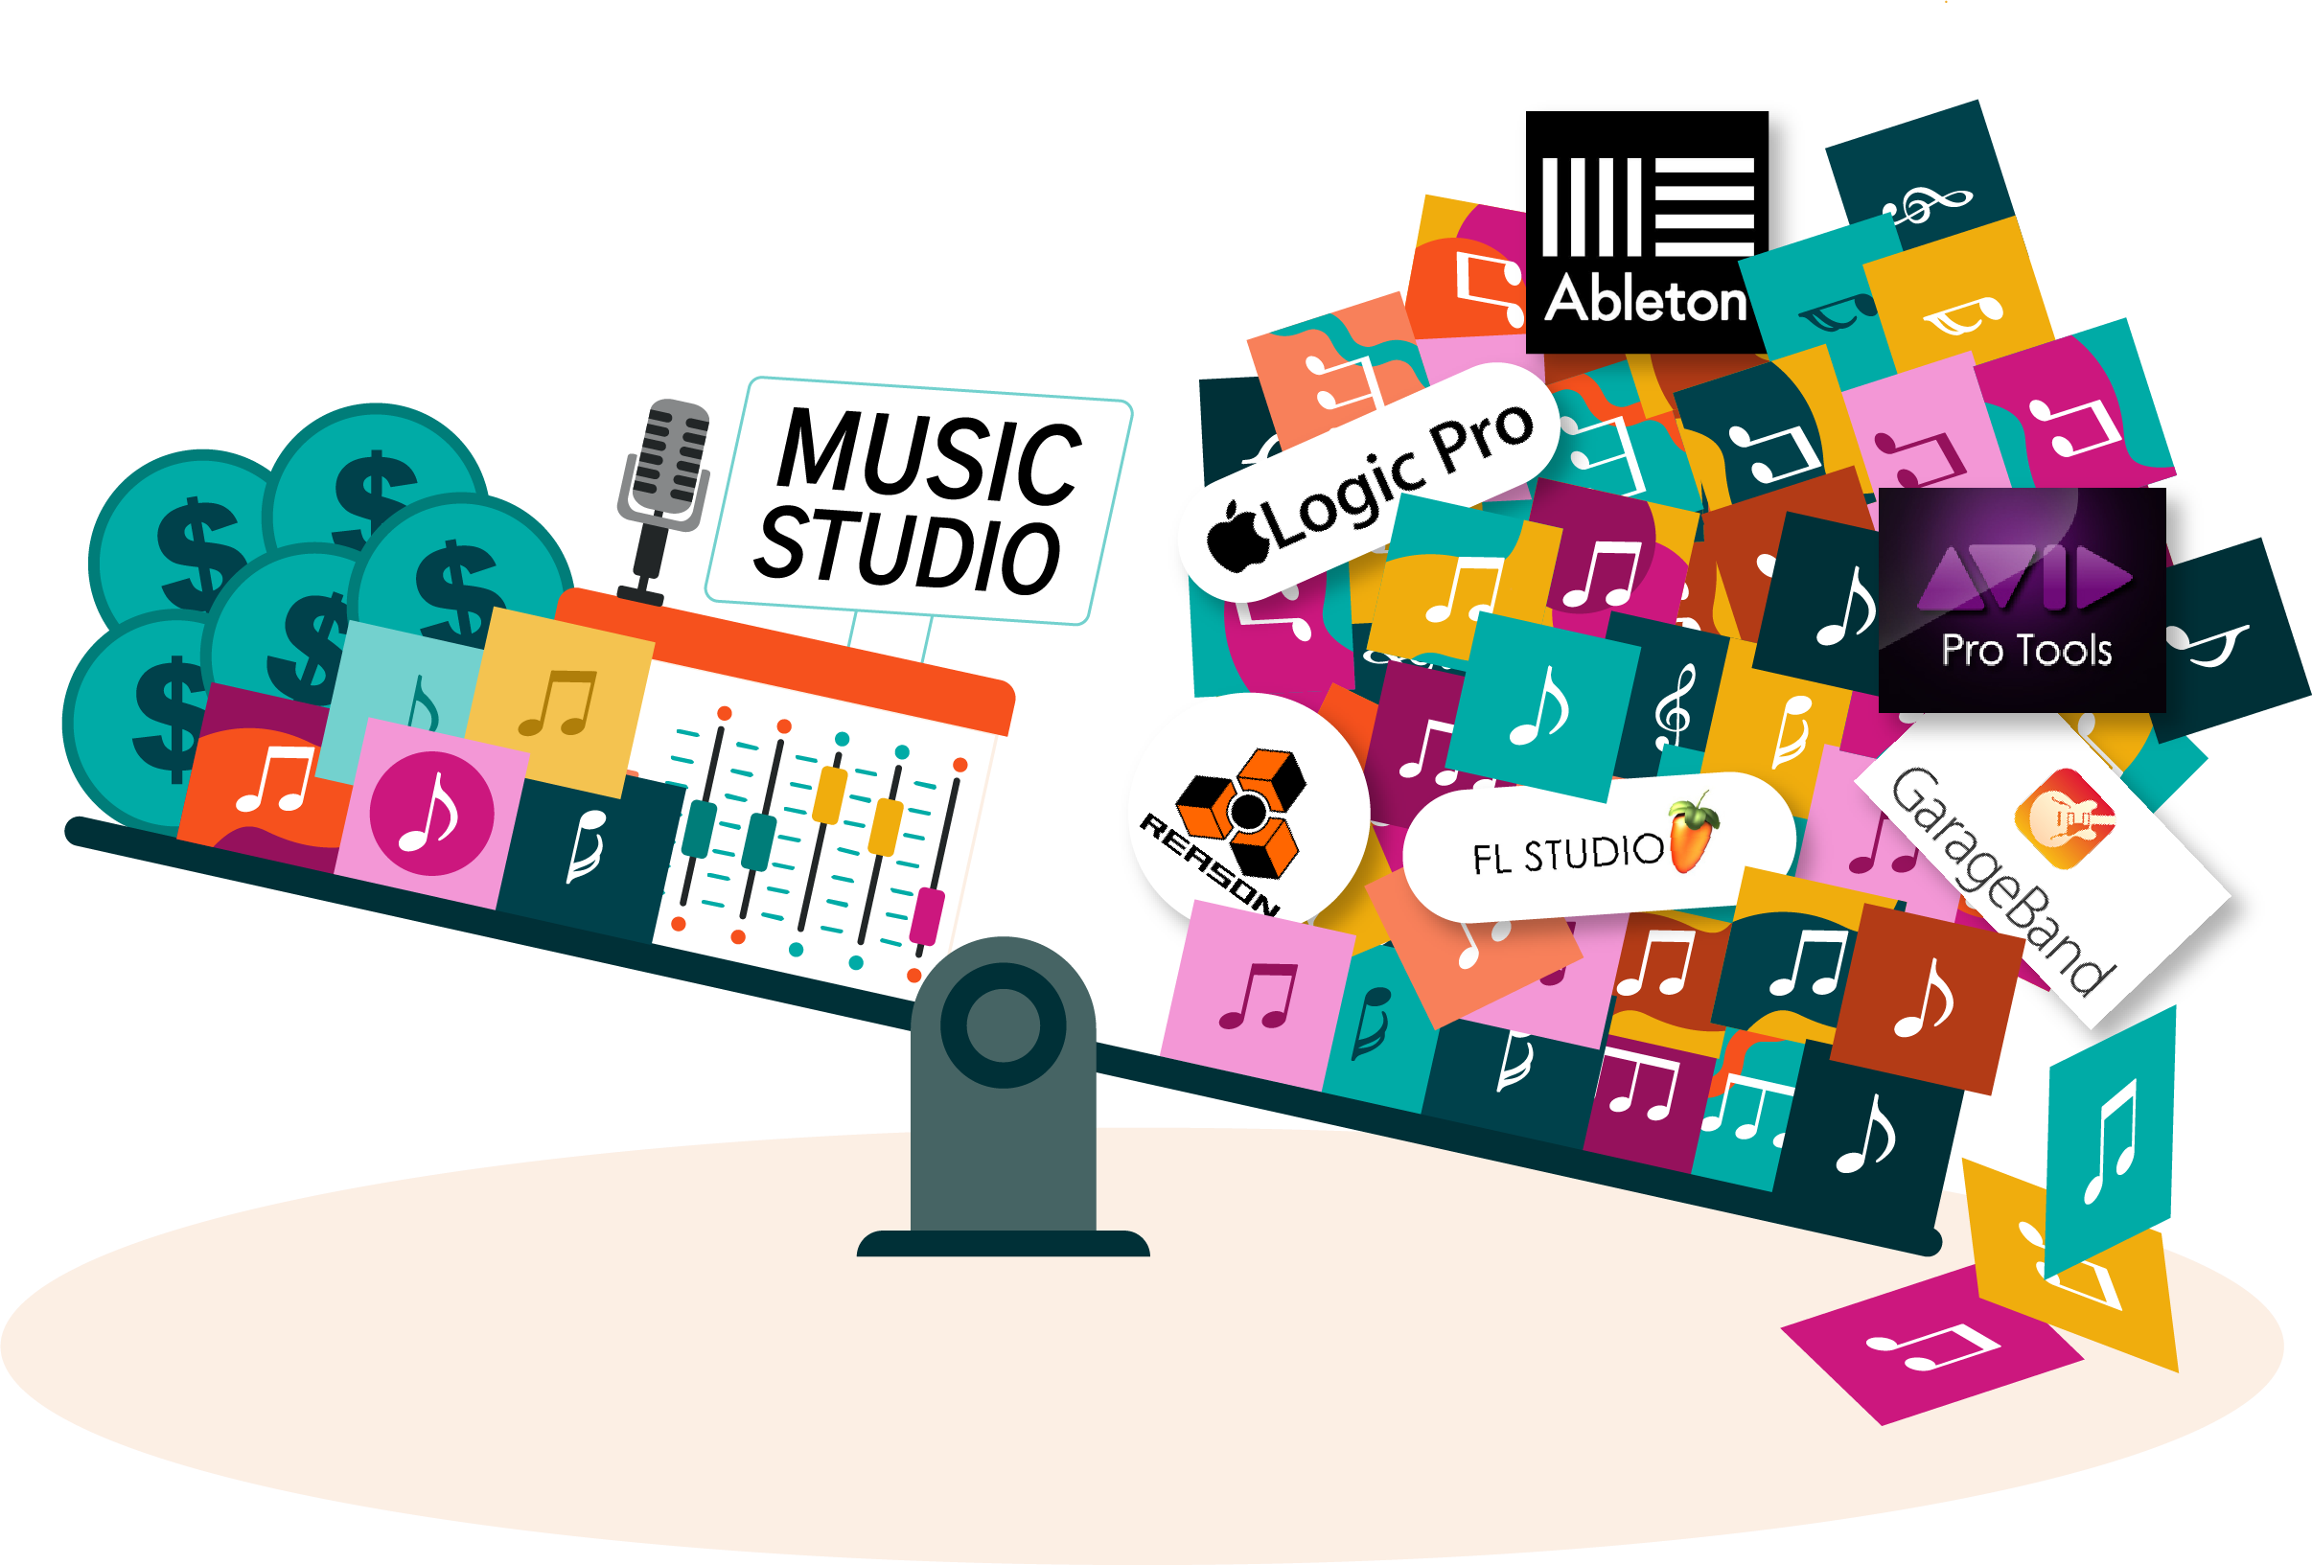
Music and Audio Content Revolution
PRE 2007
NOW (2019)
10-30 songs
released a month
40,000 songs
released a day

Slide 5

The Music Industry

Slide 6
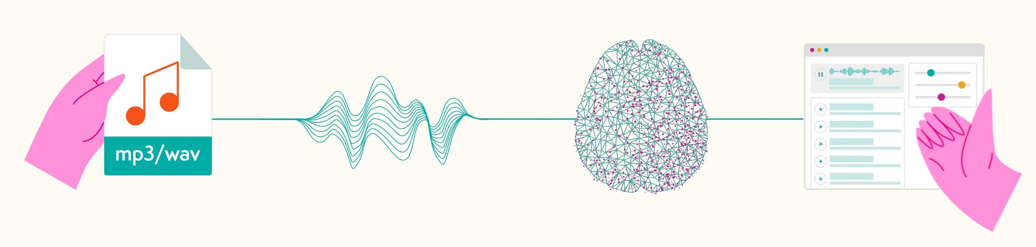
Our Technology
1
2
3
4

Slide 7
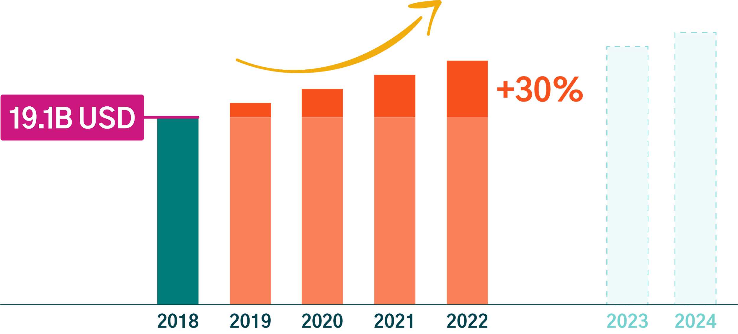
Market Sizing
Total Value of Recorded Music Industry

Slide 8






Who Do We Work With?
Current Clients
15+
Industry Sectors
Production/Sync, Streaming, Online Music Archives,
Radio, Gaming

Slide 9
Our Products
Tag
Search
Playlist

Slide 10

Search

Slide 11
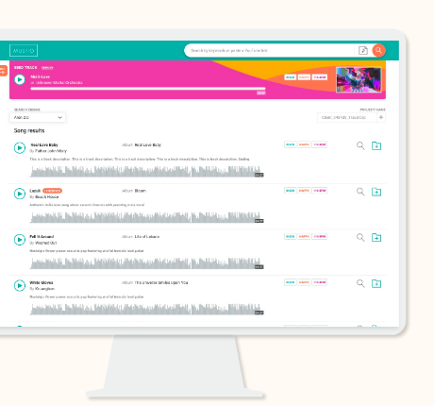
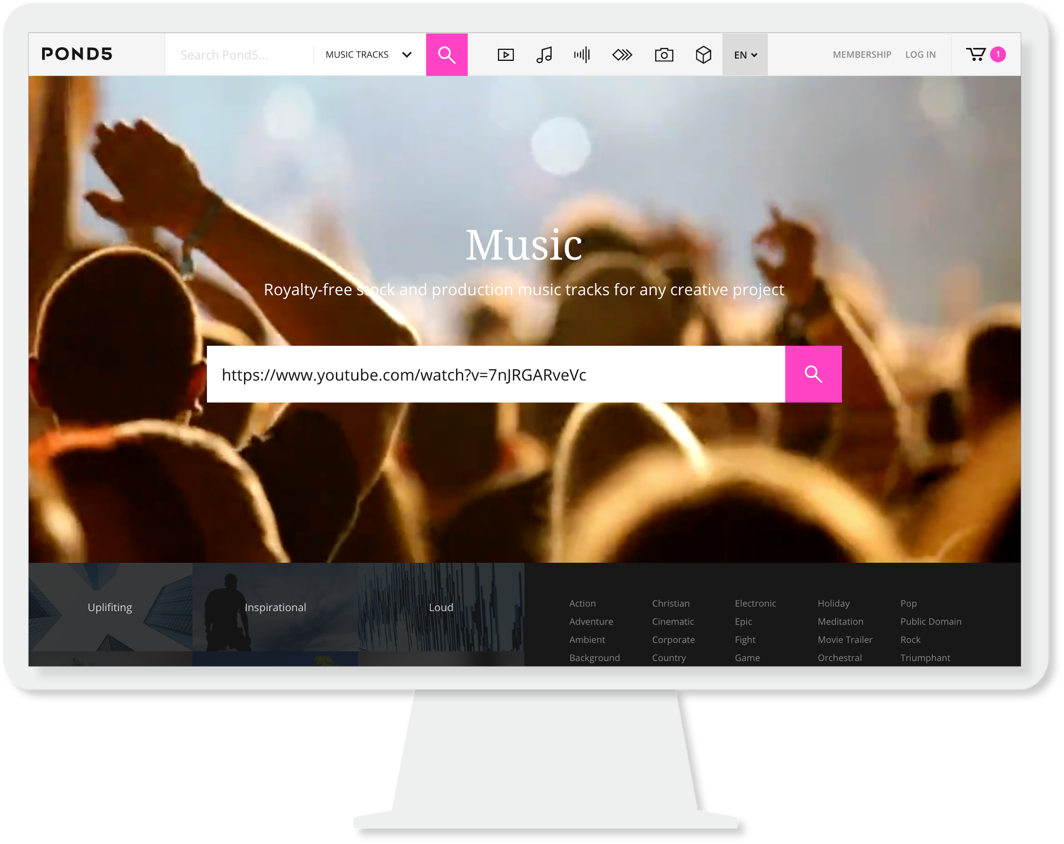
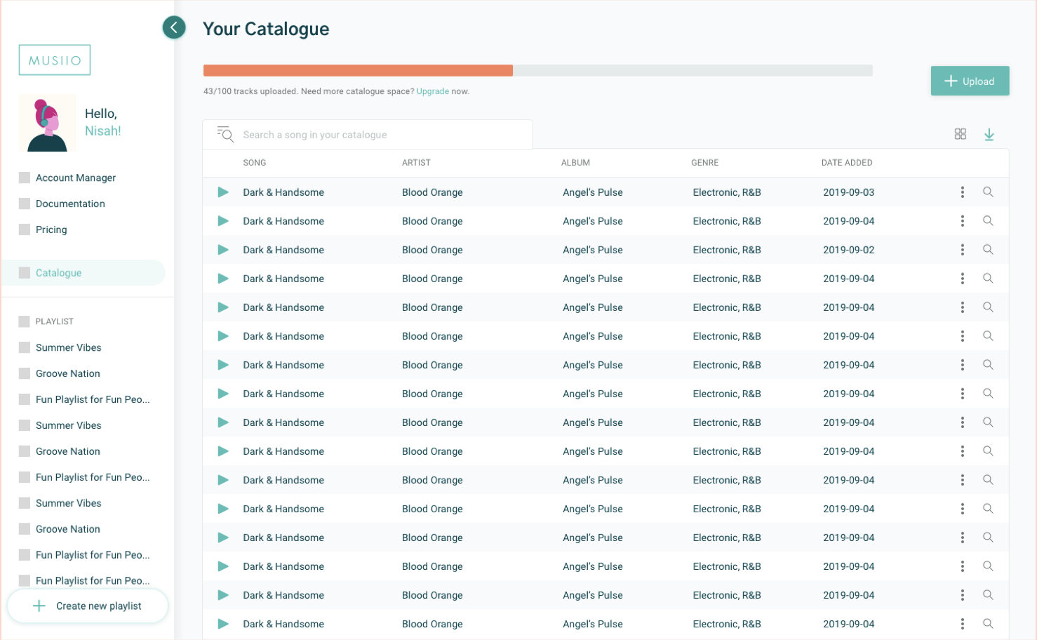
Our Products
Custom Dashboard
Musiio Tag & Search

Slide 12
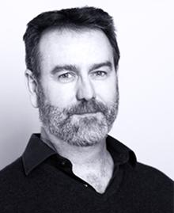

Case Study: Custom Internal Music Supervisor Dashboard
Product: Custom Internal Music Supervisor Dashboard
Tracks: 170,000+
The Challenge: Responding to briefs quickly with high quality playlists of music is increasingly difficult with a large and growing catalogue.
Current Process: The music supervisor has to work from memory, or manually break down music references and match them with everything in the database. This process could take anywhere upto 2 days and sometimes multiple supervisors to respond to a brief.
Solution: A custom dashboard which allows in-house supervisors to audio reference search their catalogue and return 10+ close audio matches in 2 seconds using a clients’ Youtube link or Mp3 reference track. A custom filter was also added so supervisors can search for a Hans Zimmer track but add vocals, change the mood or bpm, as the client requests.
“There has been so much noise coming from generative AI companies… but so few of those technology companies go beyond the hype of the technology. This is a partnership rooted in actually opportunities and real challenges around music tagging, searching just for the right track for your video project and making more of our artists and composers’ music available to our customers worldwide”
Matthew Hawn, Chief Product Officer at Audio Network
Notes:
FMA
14 playlists in 14 weeks

Slide 13




Traction
Featured In

Slide 14
Thank you!
musiio.com
hazel@musiio.com

